Slide 1
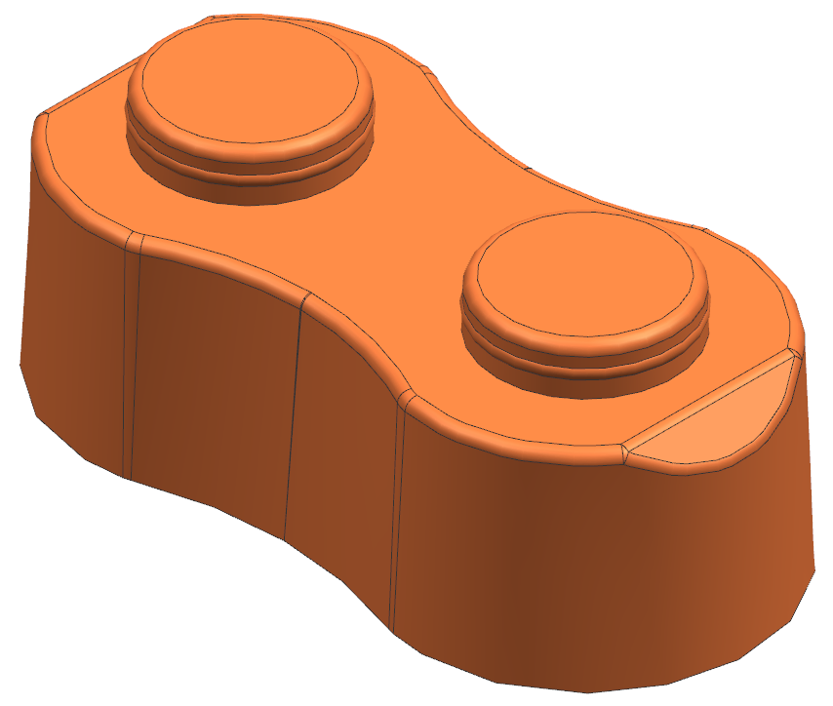
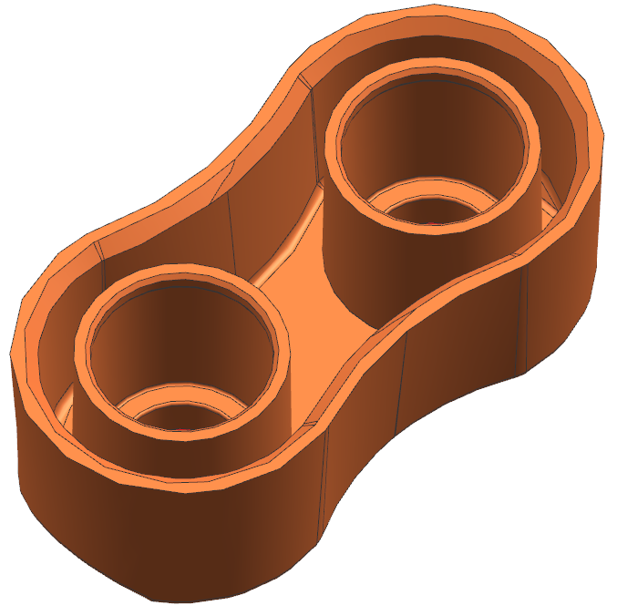
Template V4.1
DFM Report For Mold: JG23053
GREEN pages present data created by Jade Molds.
BLUE pages present information customer has provided or still needs to provide.
Customer, please fill in missing information on the BLUE customer pages and approve where asked.
Blynko Standard block
Notes:
Original DFM Date 28-03-24

Slide 2
Jade Engineering Process & Key Reminder Points
The first time we send you a DFM this page is blank. If DFM is approved on 1st pass this page is not used.
Team Jade will add reminders on this page for KEY DFM details that are outstanding, as needed.
Reminder:

Slide 3
Customer Supplied Information – PART FILE INFO
Customer: adjust bold text in green sections below as needed |  |  | Take Note
Customer provided 3D part file name | Standard block-JADE-REV00-11July2023.stp |  | *The DFM is based on the 3D part file name you see. If not correct, please advise back
2D part file name that will be used for trials | Blynko Standard block.pdf |  | *A 2D from the customer is needed before mold trials. Typically, 5-10 critical dimensions are required. Please provide to Jade if blank
Jade Quote Number (JQ): | JQ123456 |  | *The DFM is also based on the JQ quote we provided earlier. Please check to ensure this matches the same quote you are expecting
PO Number: | 123456 |  | *Please check to ensure correct PO. If blank it means we have not received your PO yet

Slide 4
Customer Supplied Information - MATERIAL
Customer: adjust bold text in green sections below as needed |  |  | Take Note
Material | ExxonMobilTM HDPE HMA 016 | Confirmed Correct? Yes | *Plastic material required. A generic or similar grade that is readily available in China it will help streamline the project
Material Source | China | Customer Answer? China | *If you select China Jade will check to see if it is possible to source material in China
Color | Yellow, Green, Blue, Red | Confirmed Correct? Yes | *Color you would like to see initial samples. Color additives can affect shrink and other material properties.
Shrink | .022 in/in (Source: Customer phone discussion) | Confirmed Correct? Yes | *Specific shrink rate. Molds cannot be built to a shrink “range”
Jade: update bold text in yellow sections as information is known |  |  | Take Note
Who provides material? | China (Jade: DO NOT update until confirmed) |  | *If China, Jade checks China availability, if customer, add tracking number when shipped
Jade to advise minimum safe amount needed for trials and/or production | 50kg |  | *lbs or kg: Jade to check against number of parts required for mold trial and any additional production parts
If Jade asked to provide, check China now | Available (Jade: pick when known – delete if not Jade) |  | *Jade to check availability NOW, advise back if available
Notes:
Replaced specifics with generic

Slide 5
Customer Supplied Information – PRESS INFO
Customer: adjust bold text in green sections below as needed |  | Take Note
Press Size (tonnage) | 230T
Tie Bar Clearance (HxV) | 22” x 22”
Min Mold Height | 7.0”
Max Mold Height | 22.0”
Max Daylight | 42.0”
Max Ejector Travel | 4.5”
Barrel Size | xx
Customer: Delete incorrect SAMPLE details below and enter correct details
Clamp slot height | .875
Locating Ring Diameter | 3.990
Nozzle Radius | 1/2”
KO Pattern | Center, 7 x 7, 4 x 16 | We require at least a center Knock out to sample
KO extension | None
KO Threads | ½-13
Water fittings | 300 (.375 ID) series | Jade Standard: 28mm diameter Counter Bore

Slide 6
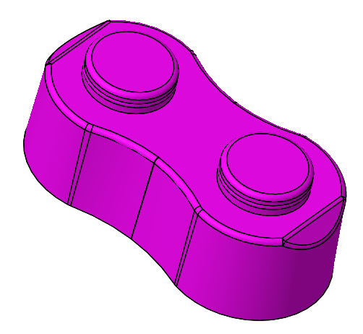
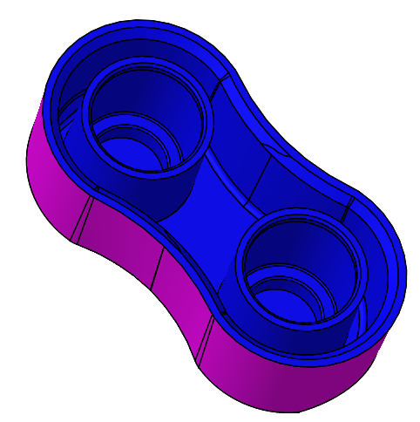
Customer Supplied Information – TEXTURE MAP FINISH
Customer: adjust bold text in green sections below as needed
Cavity Side Finish- Medium Semi-glossy finish B-2 400 Grit paper | Draft Required | Core Side Finish: Medium Semi-glossy finish B-2 400 Grit paper | Draft Required

Slide 7
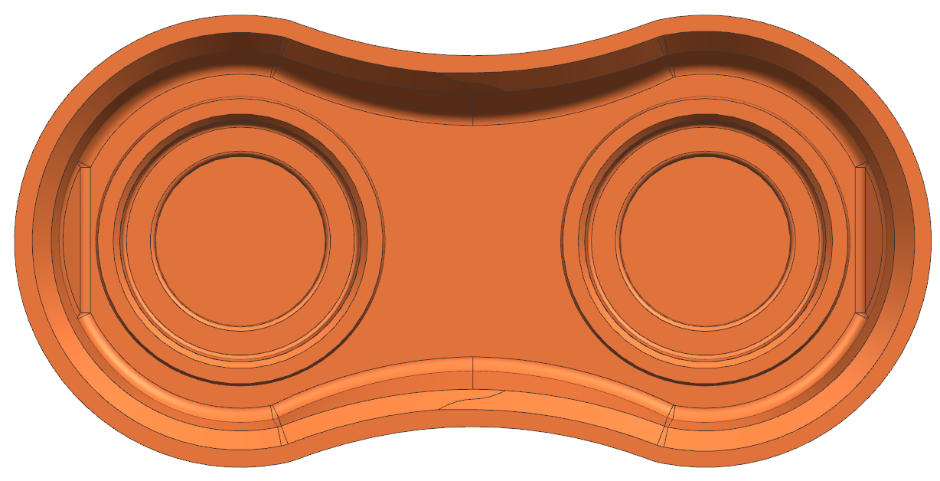
Customer Supplied Information – PART ENGRAVE DETAIL
Customer: adjust bold text in green sections below as needed
Date Code | If Date Code is Required put catalog number of the Date Code here (example “DMDP06-22”). If not required leave blank | Recycle Code | Put Recycle Code here (example HDPE2 or triangle symbol). If not required leave blank
Part Number/Rev | Put part number “Text” here (example “PN800-4329 R3”). Part number can be solid or inserted. Rev level will be inserted on a core pin | Cavity ID | A1,A2,A3,A4.....A32
Please put a screen shot of the highlighted surface where the Date Code, Part Number, Recycle Code and Core ID is located. If it is not required, remove note above. Use 1 picture only unless Core and Cavity locations are required
Cavity ID:1-2

Slide 8
Customer Supplied Information – MOLD TEXT LABELS
We want to make sure we get your outside mold text labelling right. Please fill in labels below with the exact text you want on your mold. Leaving labels blank below is OK, we just won't put it on. The choice is yours.
Customer: adjust bold text in green sections below as needed |  | Take Note
Part Name: | Blynko Standard block | This information will be engraved directly into the steel on your mold. Any fields left blank here will not be engraved. Please approve at bottom.
Part Number: | XXX
EJ Stroke: | Will be engraved on tool (in inches)
Mold Weight: | Will be engraved on tool: Total Weight(in Pounds){ B side weight (in Pounds); A side weight (in Pounds)
Year: | 2023
Mold Builder: | JADE GROUP
JADE Mold Number: | JG23053
Notes:
Revised Plaque note

Slide 9
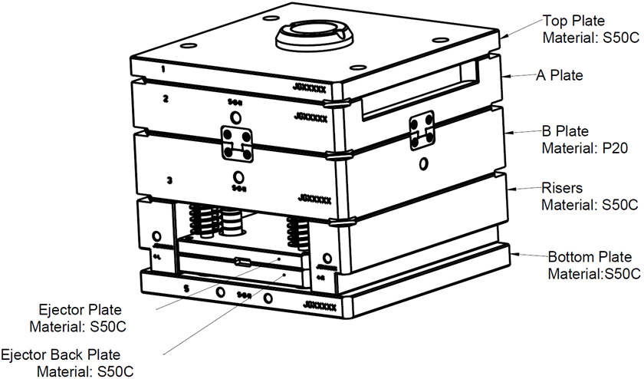
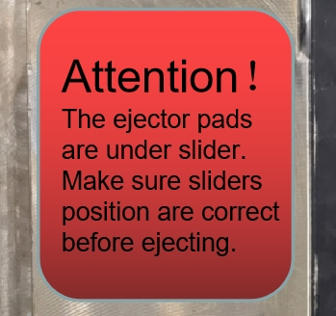
Mold Summary
Current 3D Model: See Page 2
Current 2D File: See Page 2
Cavities Qty: 32
Mold Class: 103
Mold Number: JG23053
Runner System: Hot runner into cold runner sub gate
Mold Constructions: 2 Plate Mold
Steel: Inserted
Cavity: H13 48-50 Rc Hardness
Core: H13 48-50 Rc Hardness
Slides: N/A
Lifters: N/A
Stripper Plate: H13 42-44 Rc Hardness
Mold Base Steel: S50C
Mold Features: : Parting Locks, Pry bar slots, Safety Strap, Shot Counter
Is a warning plaque required due to special mold functions?

Slide 10
Part: Core & Cavity Side
Cavity : Magenta face
Core : Blue face

Slide 11
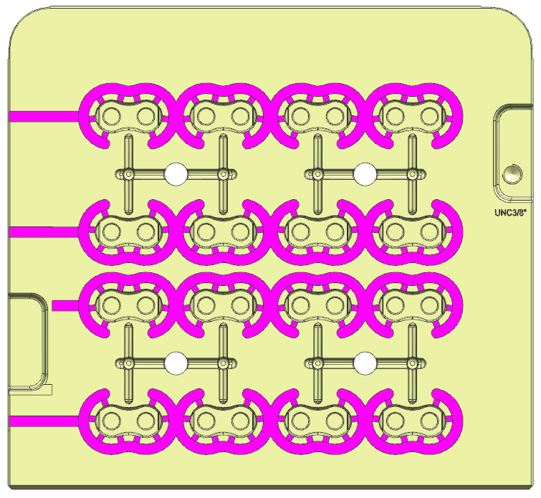
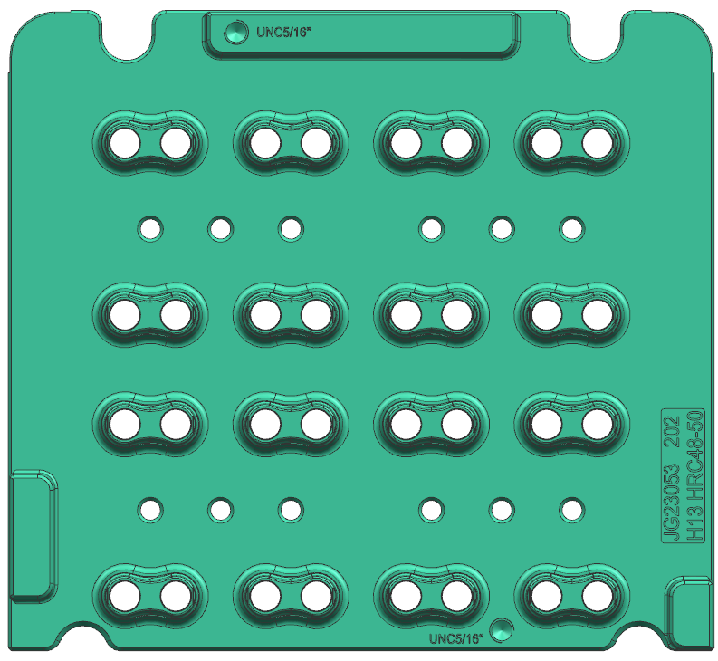
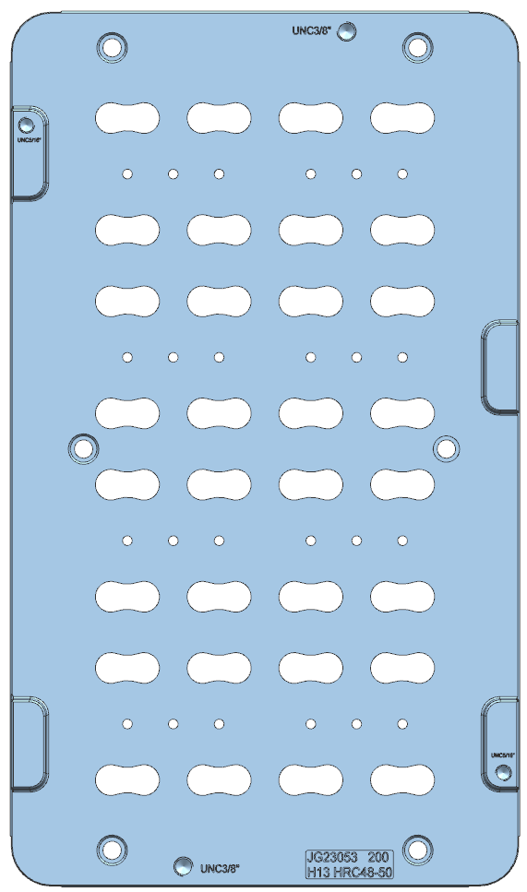
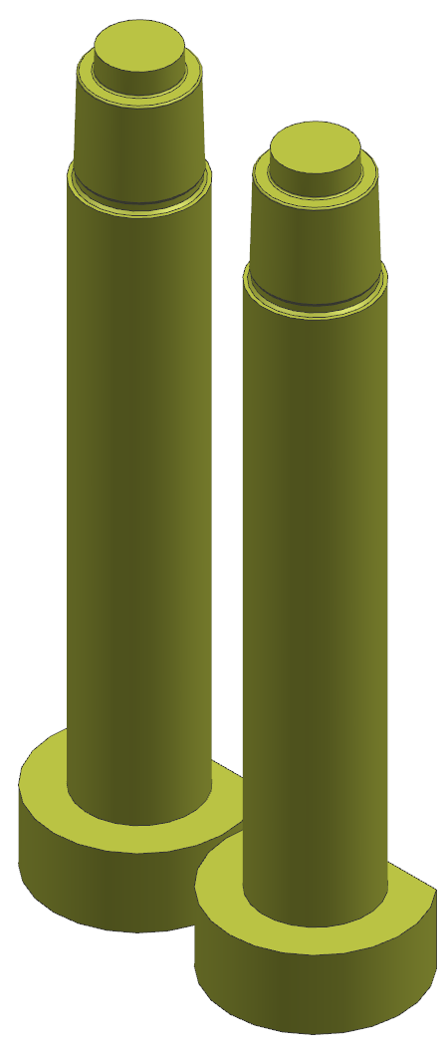
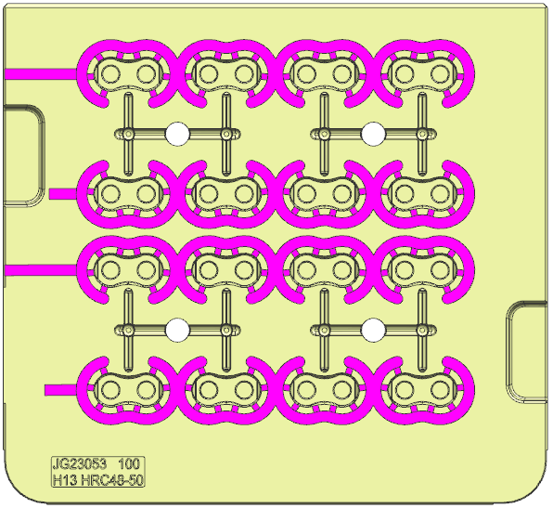
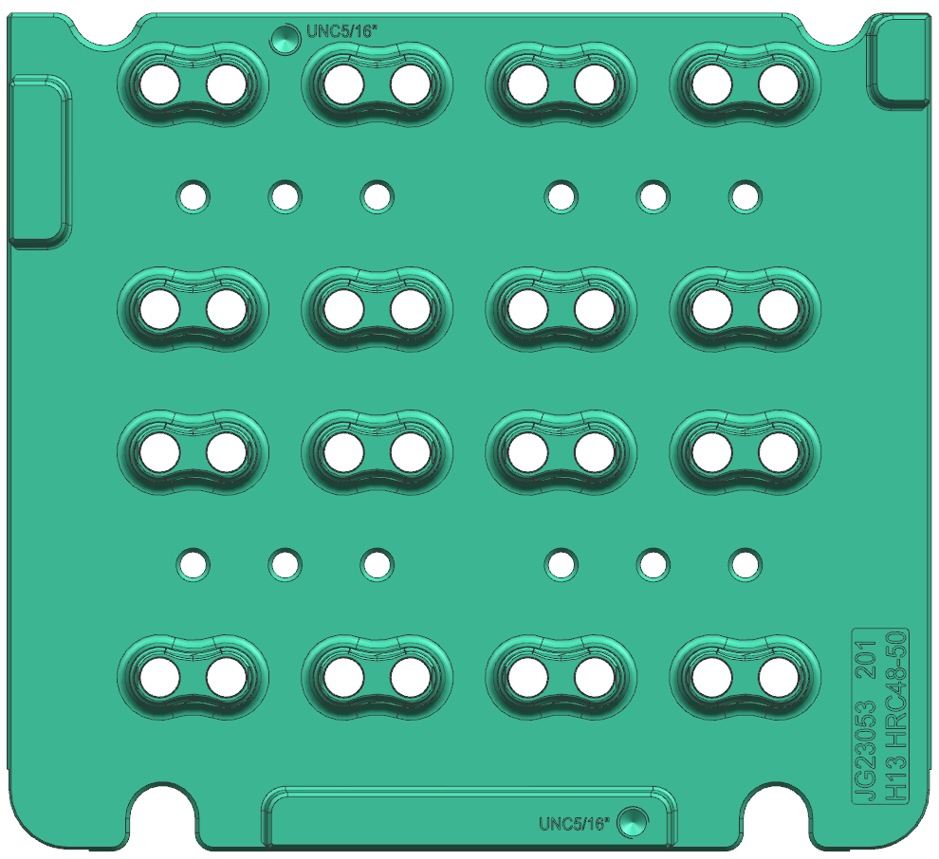
Inserts & Cooling
Cavity Insert(101)
Core Insert(202)
Stripper plate
Floating Core Sub pins
Cavity Insert (100)
Core Insert(201)

Slide 12
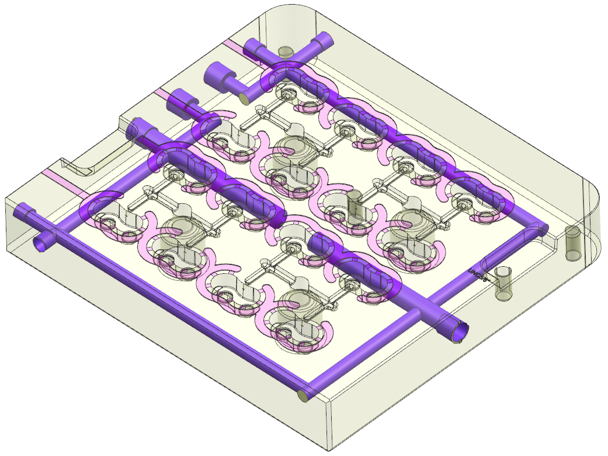
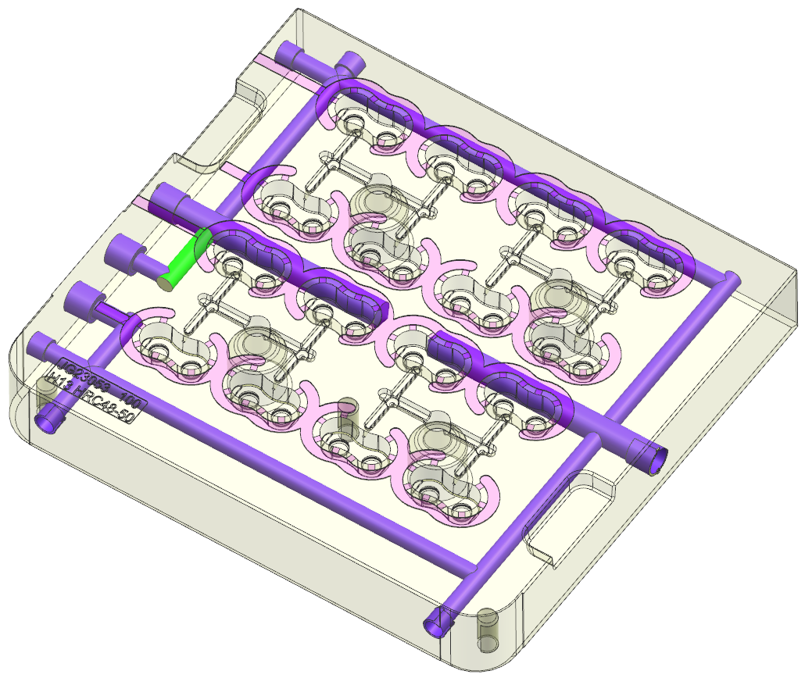
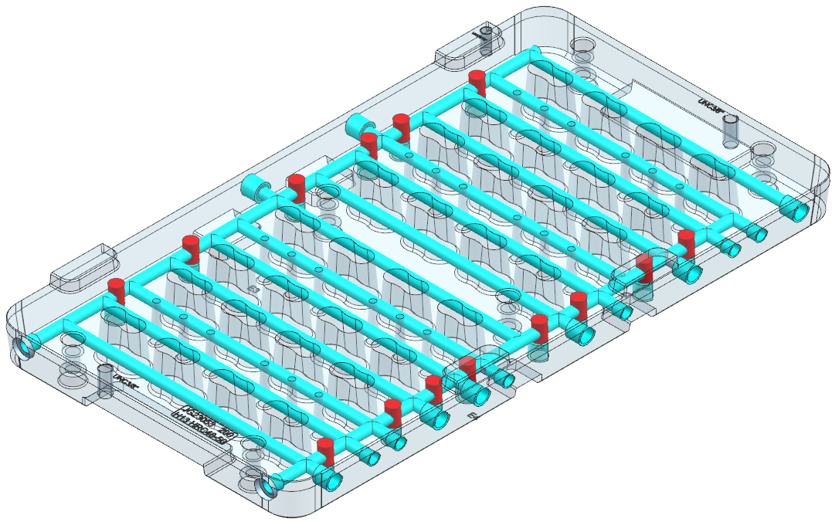
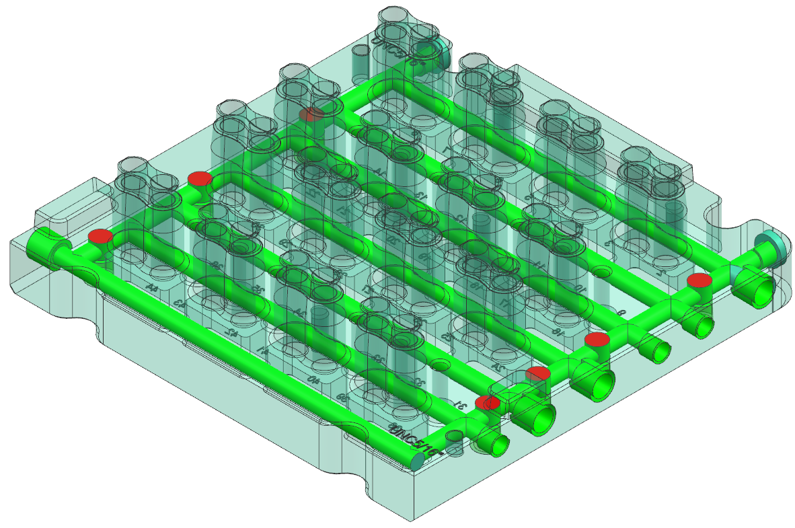
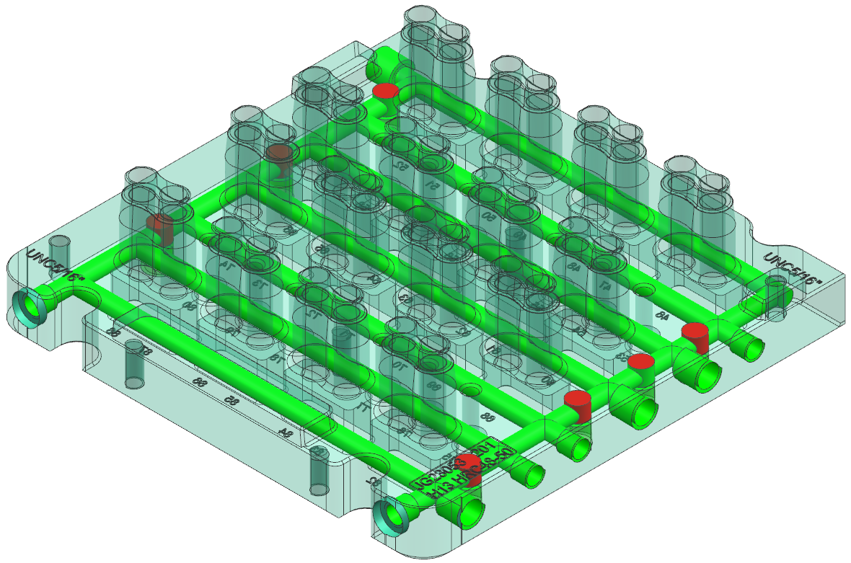
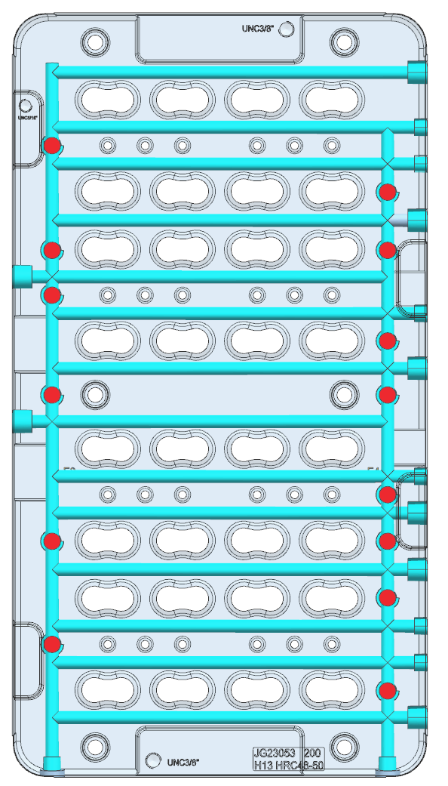
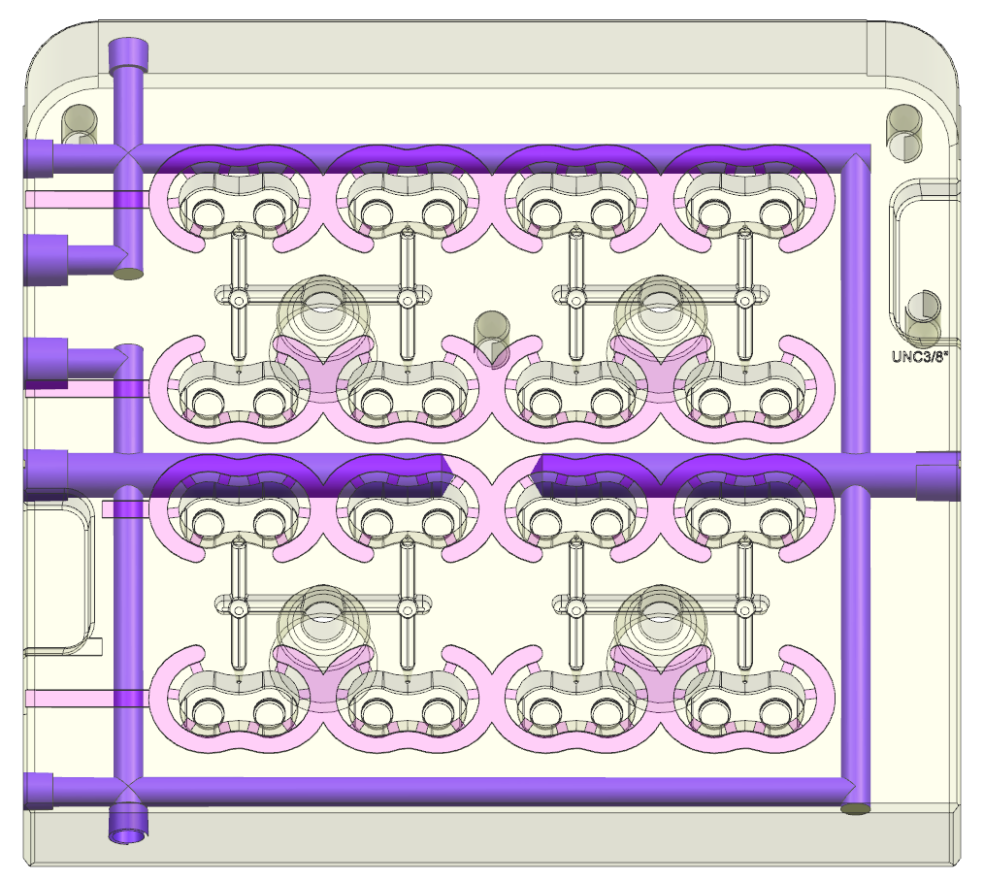
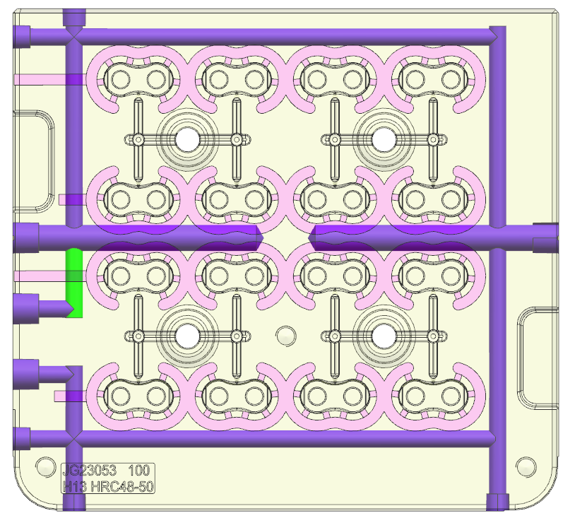
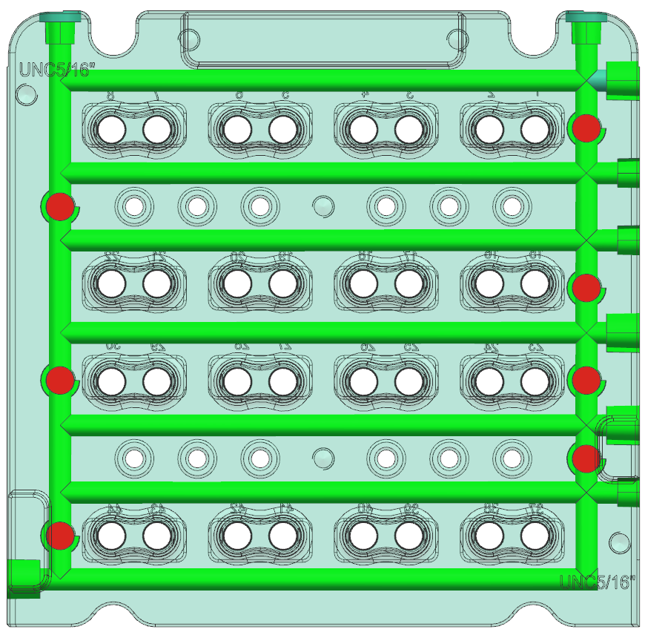
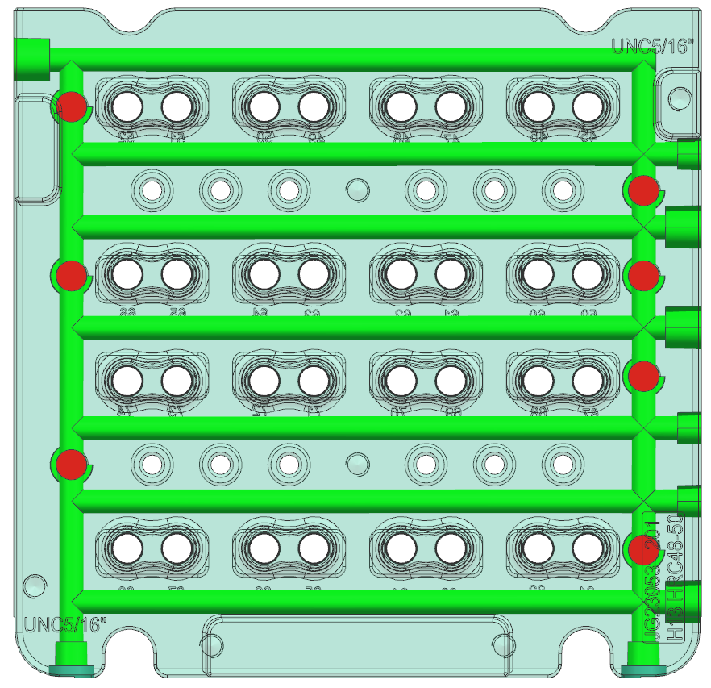
Inserts & Cooling
Cavity Insert(101)
Cavity Insert (100)
Stripper plate
Core Insert(202)
Core Insert(201)
4/10/2024

Slide 13
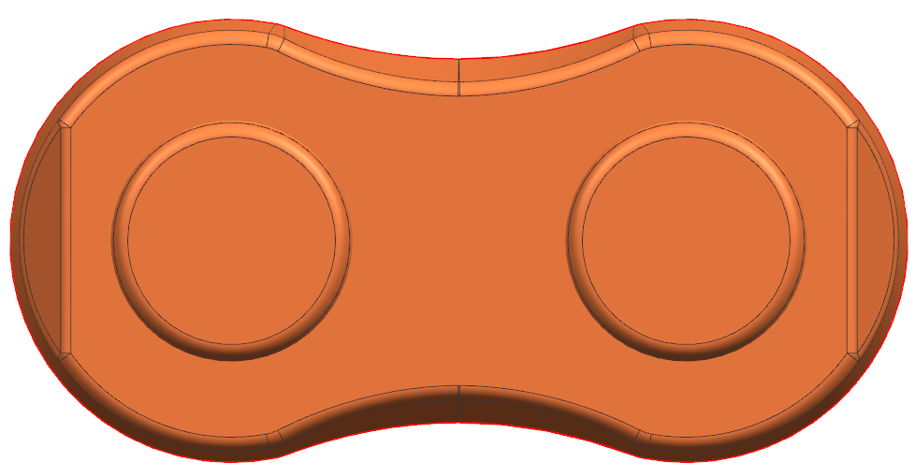
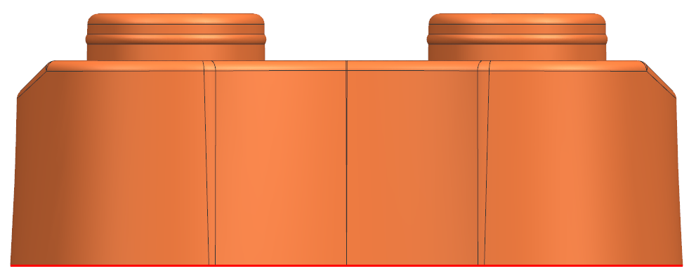
Part Lines – Witness Lines – Flow Lines
P_{L}
Parting Line Highlighted in Red

Slide 14
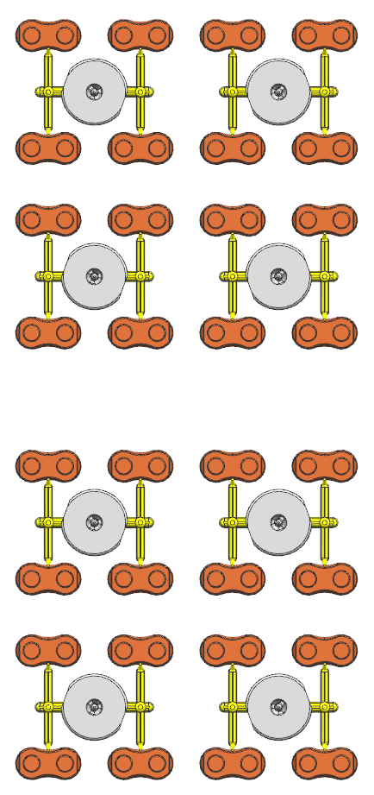
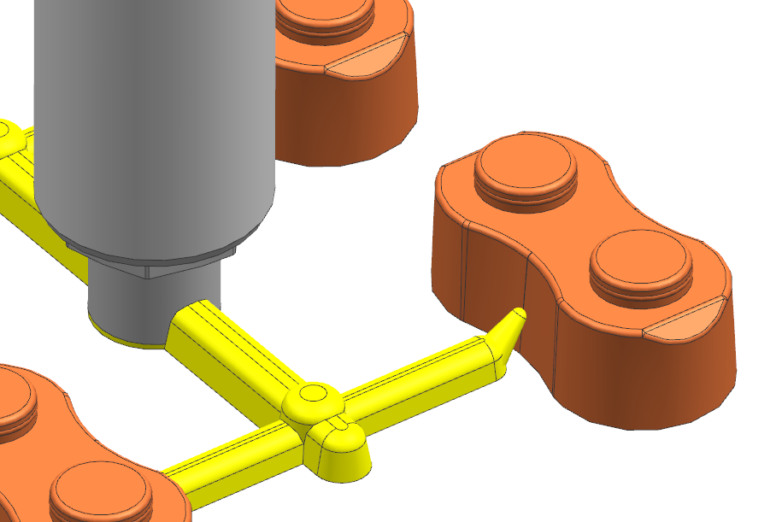
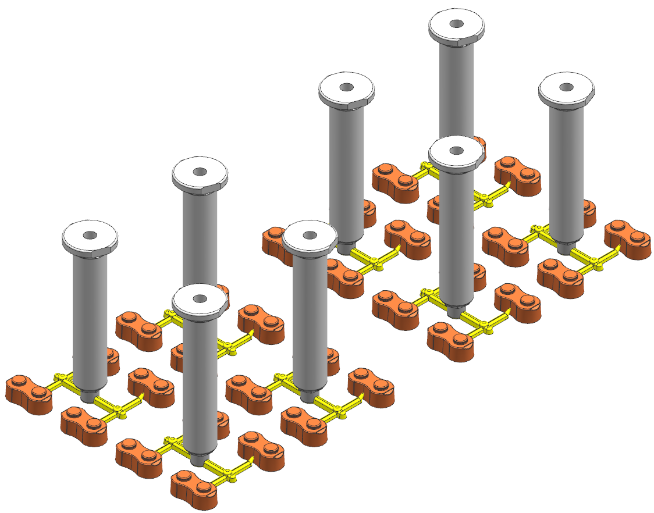
Runners & Gates
Runner Type: Hot Runner
Number of Gates per Part: 1
Type of gate: Sub gate
1X Direct gate /part
Gate opening Ø1.2mm
Replace URL below with URL to Mold Flow
https://www.jademolds.com/
Gate mark (vestige) can form a visual imperfection on the part

Slide 15
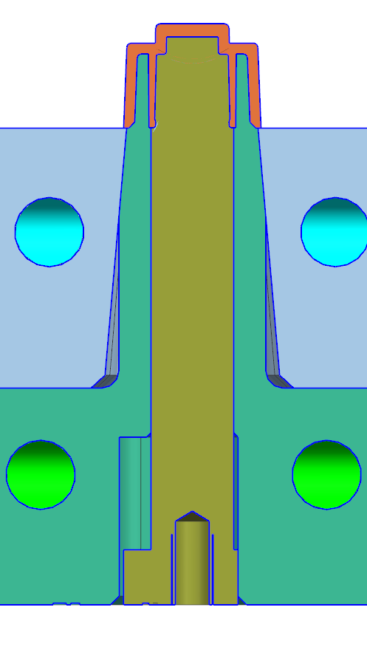
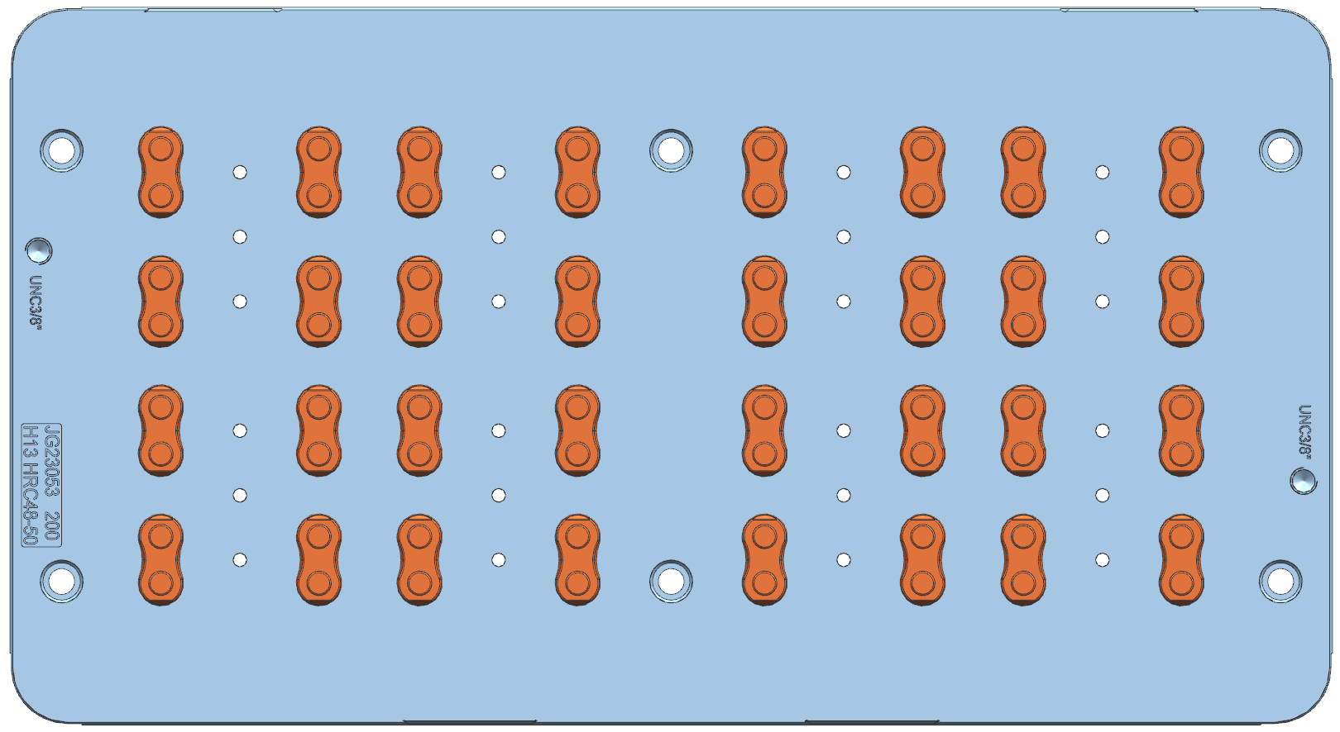
Ejection System
Stripper plate
Ejector pin ejection
Floating Core Pins
Core pins will be spring loaded. They will move along with stripper plate and stop after 8mm of ejection and stripper will continue forward and eject the part.
Ejector Direction
Jade Ejector system standards include
Guided Ejection, Support Pillars, Spring Return, Tied In Knock Outs

Slide 16
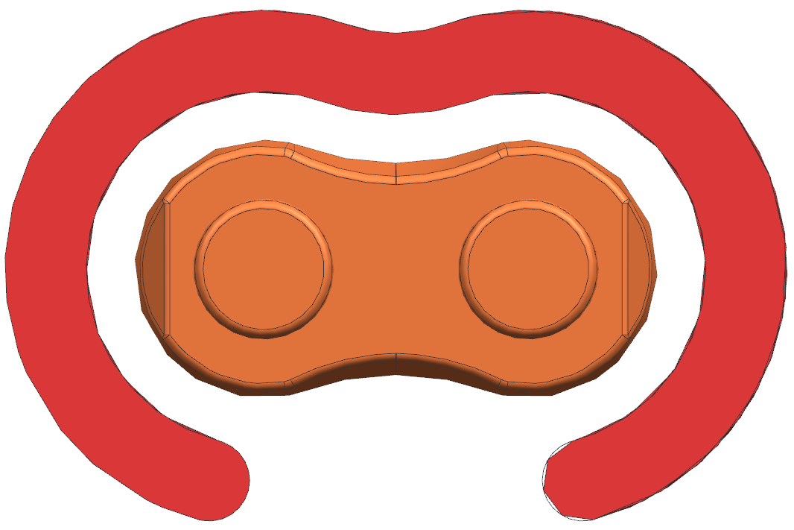
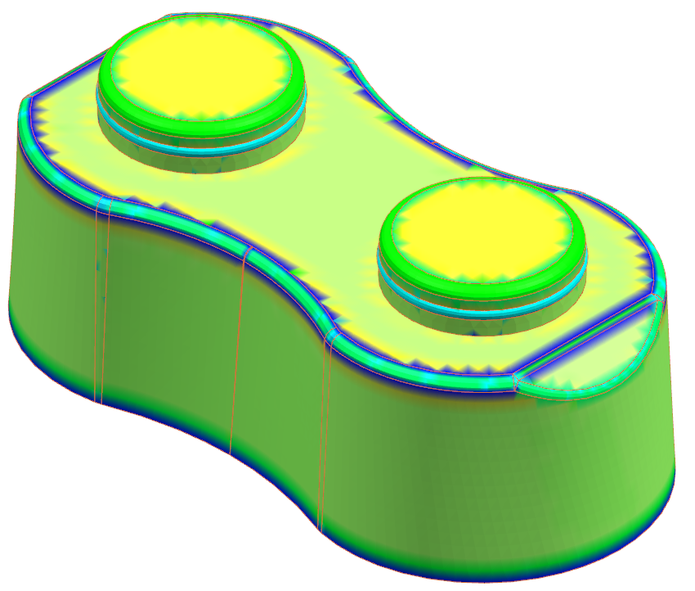
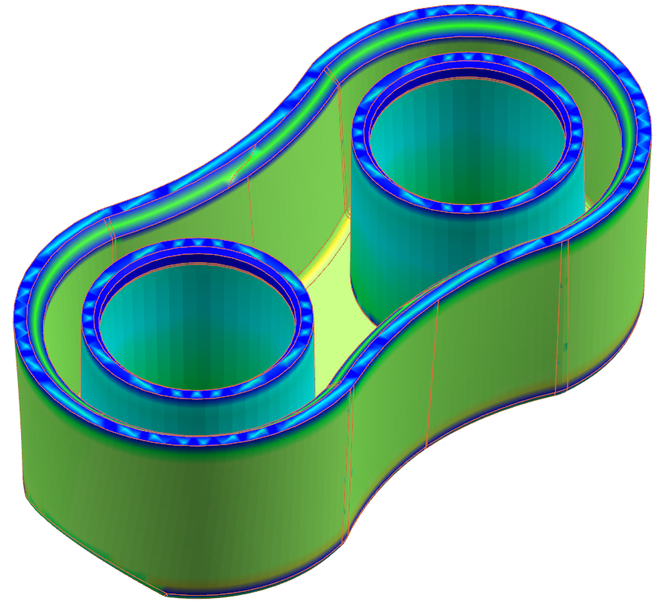
Sink Marks/Wall Thickness Analysis – Standard Venting
VENTING SYSTEM
WALL THICKNESS ANALYSIS
Venting system in the mold is required to avoid air traps in mold cavity.
Wall thickness variation should be within tolerance limit, so it will allow smooth filling of the mold, otherwise, a sink mark may be observed.
Minimum : 0.67mm
Maximum : 1.62mm
Average : 1.01mm
Venting
In the above part, due to the melt fill, the air traps are coming in the weld line areas and end of fill areas. To avoid short fill in the EOF areas we used perimeter venting

Slide 17
Sink Marks/Wall Thickness Analysis – Venting Plus
Are all sub inserts and pins vented?
Are all vents to atmosphere?
Answer and illustrate on this side.

Slide 18
Sink Marks/Wall Thickness Analysis – Moldex3D Venting
Illustrate specific call out issues that Moldex3D has identified.
If needed. Once Moldex3D is done.

Slide 19
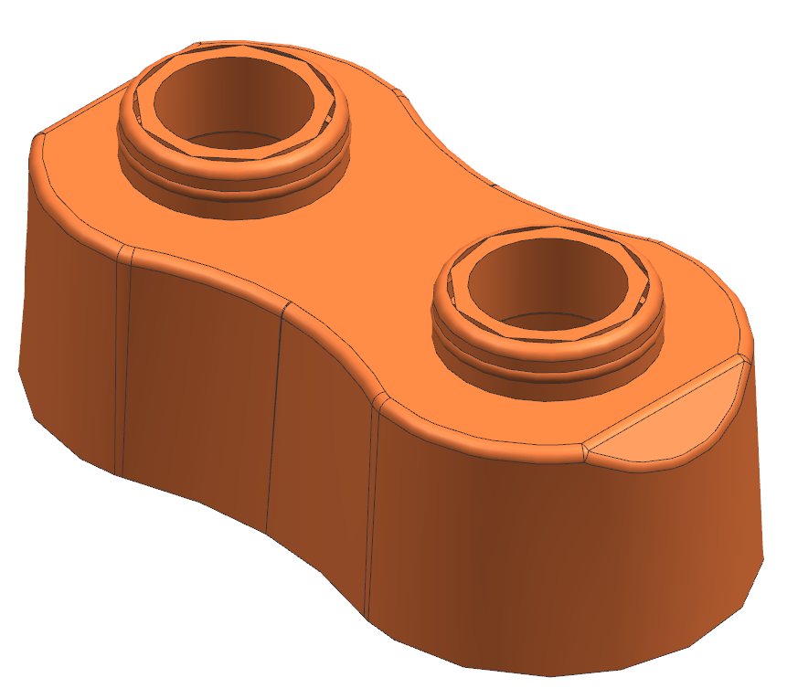
Part Changes (11-07-23)
Please confirm if we need to make 2 versions. V1 without hole, V2 with hole.
请客人确认此款通孔产品是否需要进行设计？

Slide 20
DFM Approval
3D file Name: Standard block-JADE-REV00-11July2023.stp
It is certified that the above-mentioned DFM for mold is checked and approved for 3D Mold Design in all respects.
Sign:
Date:

Slide 21
We look forward to getting your quick feedback so we can move towards a fast DFM approval, which will help keep your T1 date on track. craig.nelson@jademolds.com to discuss.
Thank You

